Slide 1
Electroencephalogram (EEG)
CINe. Lab 엄태현
CINe. Lab 김동주

Slide 2
EEG (Electroencephalogram)
The electroencephalogram (EEG) measures the activity of large numbers (populations) of neurons.
First recorded by Hans Berger in 1929.
EEG recordings are noninvasive, painless, do not interfere much with a human subject’s ability to move or perceive stimuli, are relatively low-cost.
Electrodes measure voltage-differences at the scalp in the microvolt (μV) range.
Voltage-traces are recorded with millisecond resolution – great advantage over brain imaging (fMRI or PET).

Slide 3
EEG (Electroencephalogram)
Used to measure Electrical activity of the brain
Detects activity of large groups of neurons that are active at the same time
Primarily measures postsynaptic potentials (not action potentials)

Slide 4
EEG vs fMRI
Spatial and temporal resolution
If you want to study the sequence of events from 0-500 ms poststimulus
Cost
$10/hour
Tolerability
Infants and children, obese people, anxious people

Slide 5
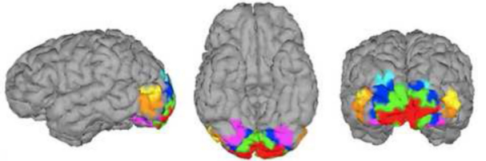
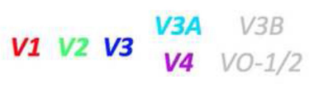
EEG vs fMRI
Spatial and temporal resolution
If you want to differentiate V2 from V4 (defined areas in brain)
Cost
$500/hour
Tolerability
Infants and children, obese people, anxious people

Slide 6
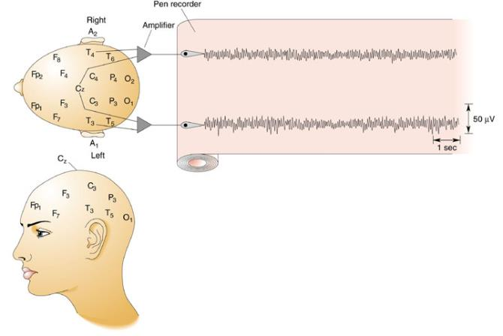
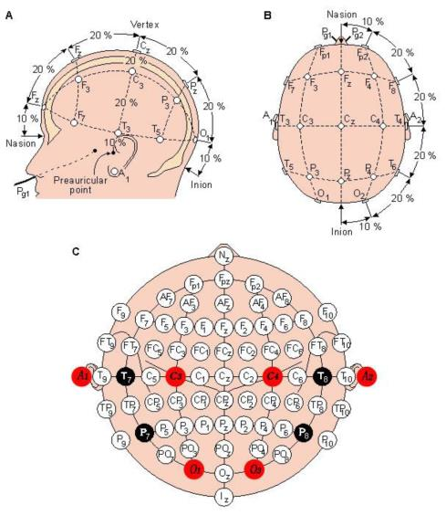
10-20 system
Standard placements of electrodes on the human scalp:
A, auricle; C, central; F, frontal; Fp, frontal pole; O, occipital; P, parietal; T, temporal.
Even number : right side of head
odd number : left side of head
Notes:
This figure shows a standard placements of electrodes on the human scalp

Slide 7
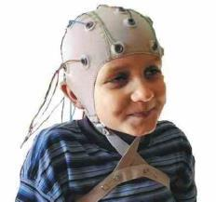
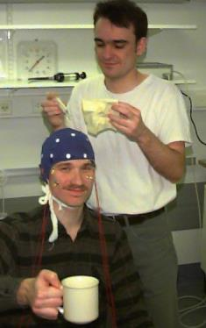
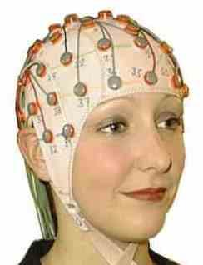
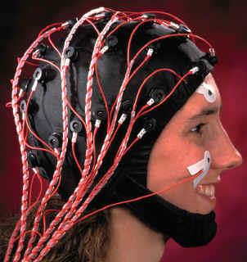
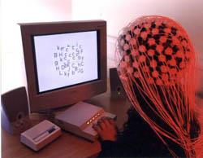
EEG
From a slide by Tom Busey at Indiana University
Notes:
An actual usage example is as follows

Slide 8
Modified Combinational Nomenclature
Higher-resolution systems
extra electrodes are added using the 10% division, which fills in intermediate sites halfway between those of the existing 10–20 system
New Letter codes
AF – between Fp and F
FC – between F and C
FT – between F and T
CP – between C and P
TP – between T and P
PO – between P and O
Renames four electrodes of the 10–20 system
T3 is now T7
T4 is now T8
T5 is now P7
T6 is now P8

Slide 9
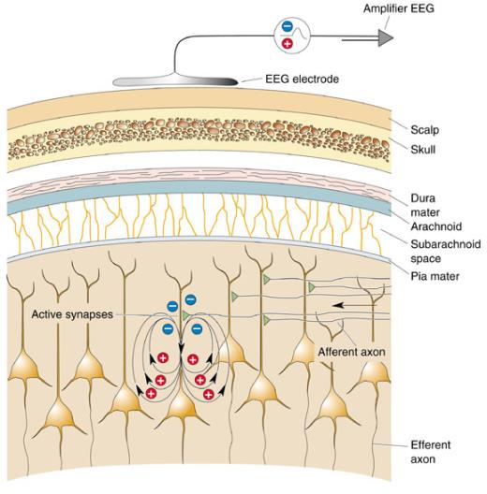
EEG
Can be used to measure brain activity that occurs during an event, or to measure spontaneous brain activity
activity that occurs in association with an event is sometimes called the event-related potential

Slide 10
EEG
The way of EEG works
Check the electrical activity that occurs in neurotransmission (Synapse)
The movement of positive and negative charge
Many neurons need to sum their activity in order to be detected by EEG electrodes

Slide 11
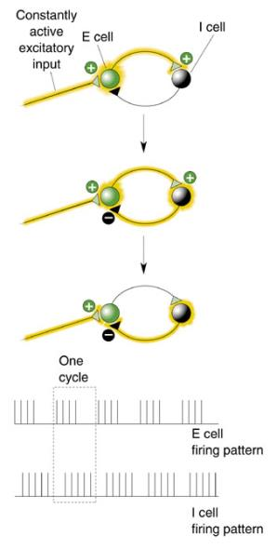
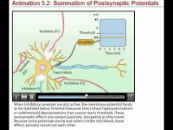
A simple circuit
http://youtu.be/v5_ynMBgt88
Notes:
EPSP : Excitatory Postsynaptic Potential : +
IPSP : inhibitory Postsynaptic Potential : -

Slide 12
EEG
Use differential amplifier kind of machinery

Slide 13
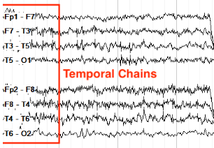
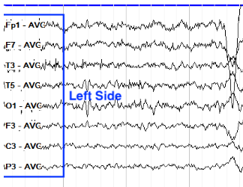
EEG
Normal double banana montage
Normal Average Referential Montage
Notes:
The focus is on calculating the potential difference between the signals obtained from the two electrodes.

Slide 14
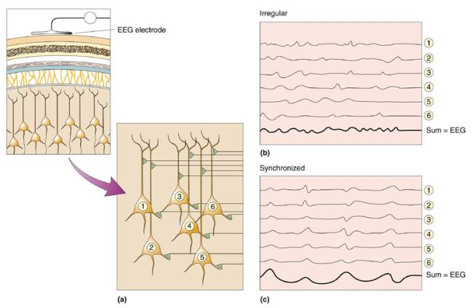
EEG
Many neurons need to sum their activity in order to be detected by EEG electrodes.
The timing of their activity is crucial.
Synchronized neural activity produces larger signals.
From a slide by Tom Busey at Indiana University

Slide 15
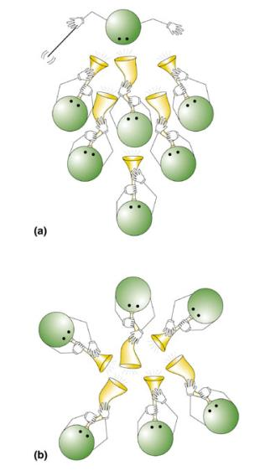

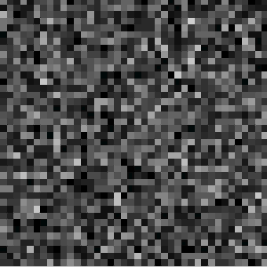
Synchronicity of Neuron
Two ways of generating synchronicity: a) pacemaker; b) mutual coordination
1600 oscillators (excitatory cells)
un-coordinated
coordinated

Slide 16
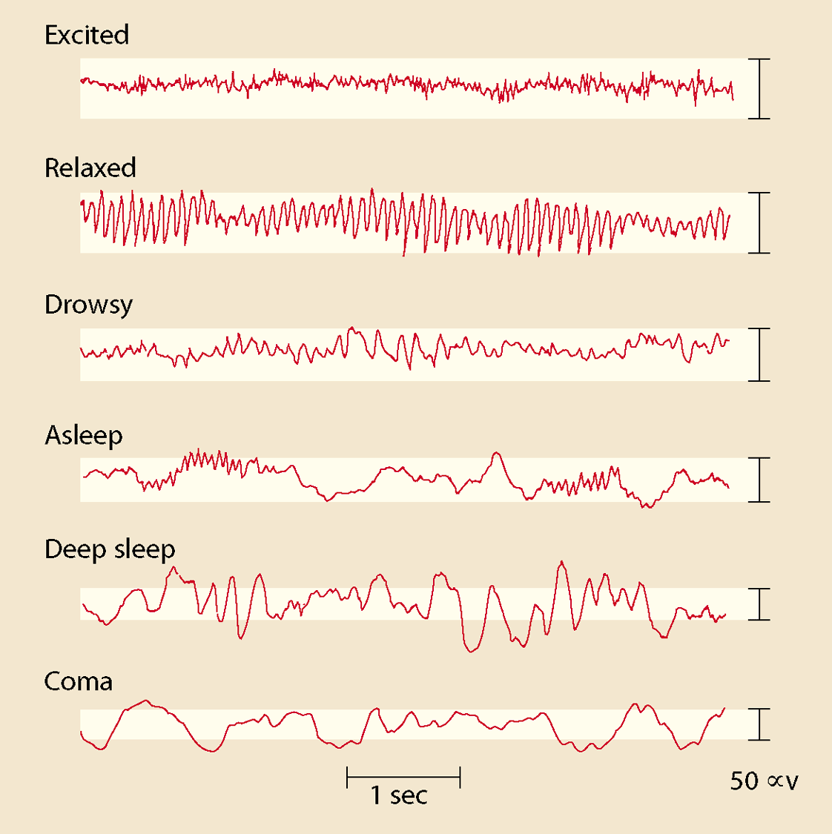
EEG
EEG potentials are good indicators of global brain state.
They often display rhythmic patterns at characteristic frequencies

Slide 17
EEG
EEG rhythms correlate with patterns of behavior (level of attentiveness, sleeping, waking, seizures, coma).
Rhythms occur in distinct frequency ranges:
Gamma: 20-60 Hz (“cognitive” frequency band)
Beta: 14-20 Hz (activated cortex)
Alpha: 8-13 Hz (quiet waking)
Theta: 4-7 Hz (sleep stages)
Delta: less than 4 Hz (sleep stages, especially “deep sleep”)
Higher frequencies: active processing, relatively de-synchronized activity (alert wakefulness, dream sleep).
Lower frequencies: strongly synchronized activity (nondreaming sleep, coma).

Slide 18
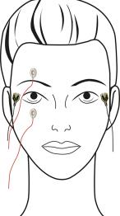
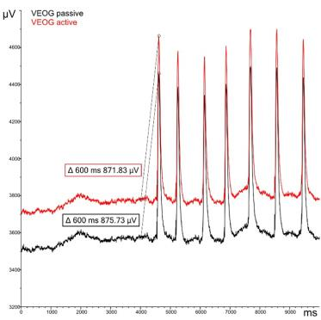
Artifact
Ocular artifact
caused by a potential difference between the cornea and the retina.
Most of the eye blinking or vertical eyelid movement causes a large potential difference between the upper and lower safety channels of the eye.

Slide 19
Artifact
Ocular artifact
From an EEG point of view, it is noise and appears in the theta (4-7 Hz) or alpha (7-14 Hz) range.
Use Artifact Filtering Method
ex) Adaptive lattice Filter

Slide 20
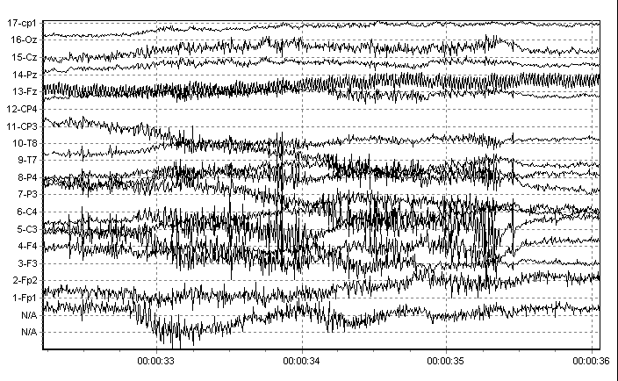
Artifact
Muscle artifact
Occurs in the muscles around the skull
Since it appears in a different band than the EEG signal, it can be removed through frequency filtering.

Slide 21
Wearable EEG device & usage of EEG
Wearable EEG device example
EMOTIV device
Experiment on using EMOTIV device
Various devices
EEG & sleep
EEG & dementia
Conclusion
Notes:
I’ll talk about wearable EEG devices and usage of EEG

Slide 22
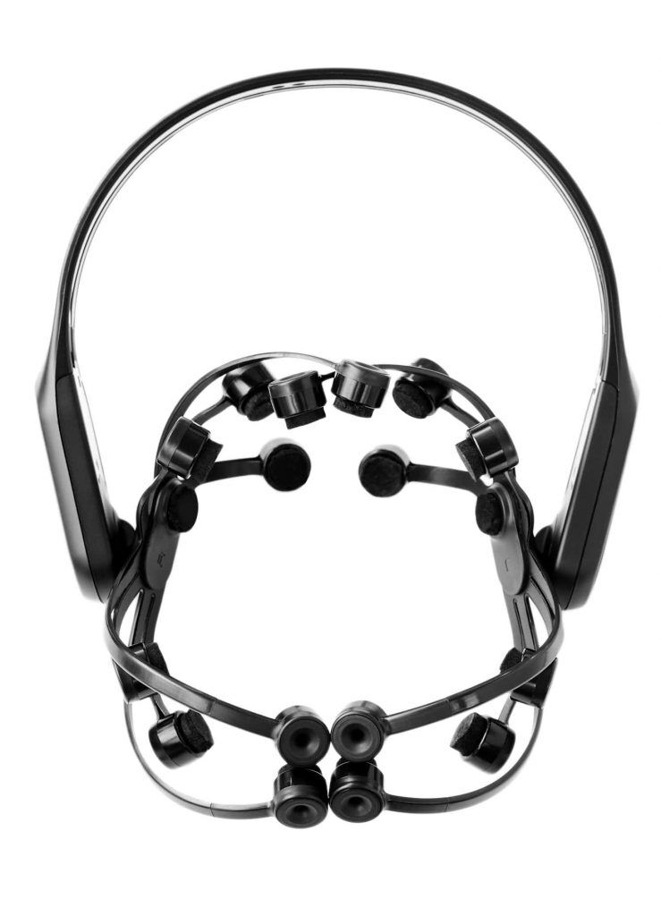
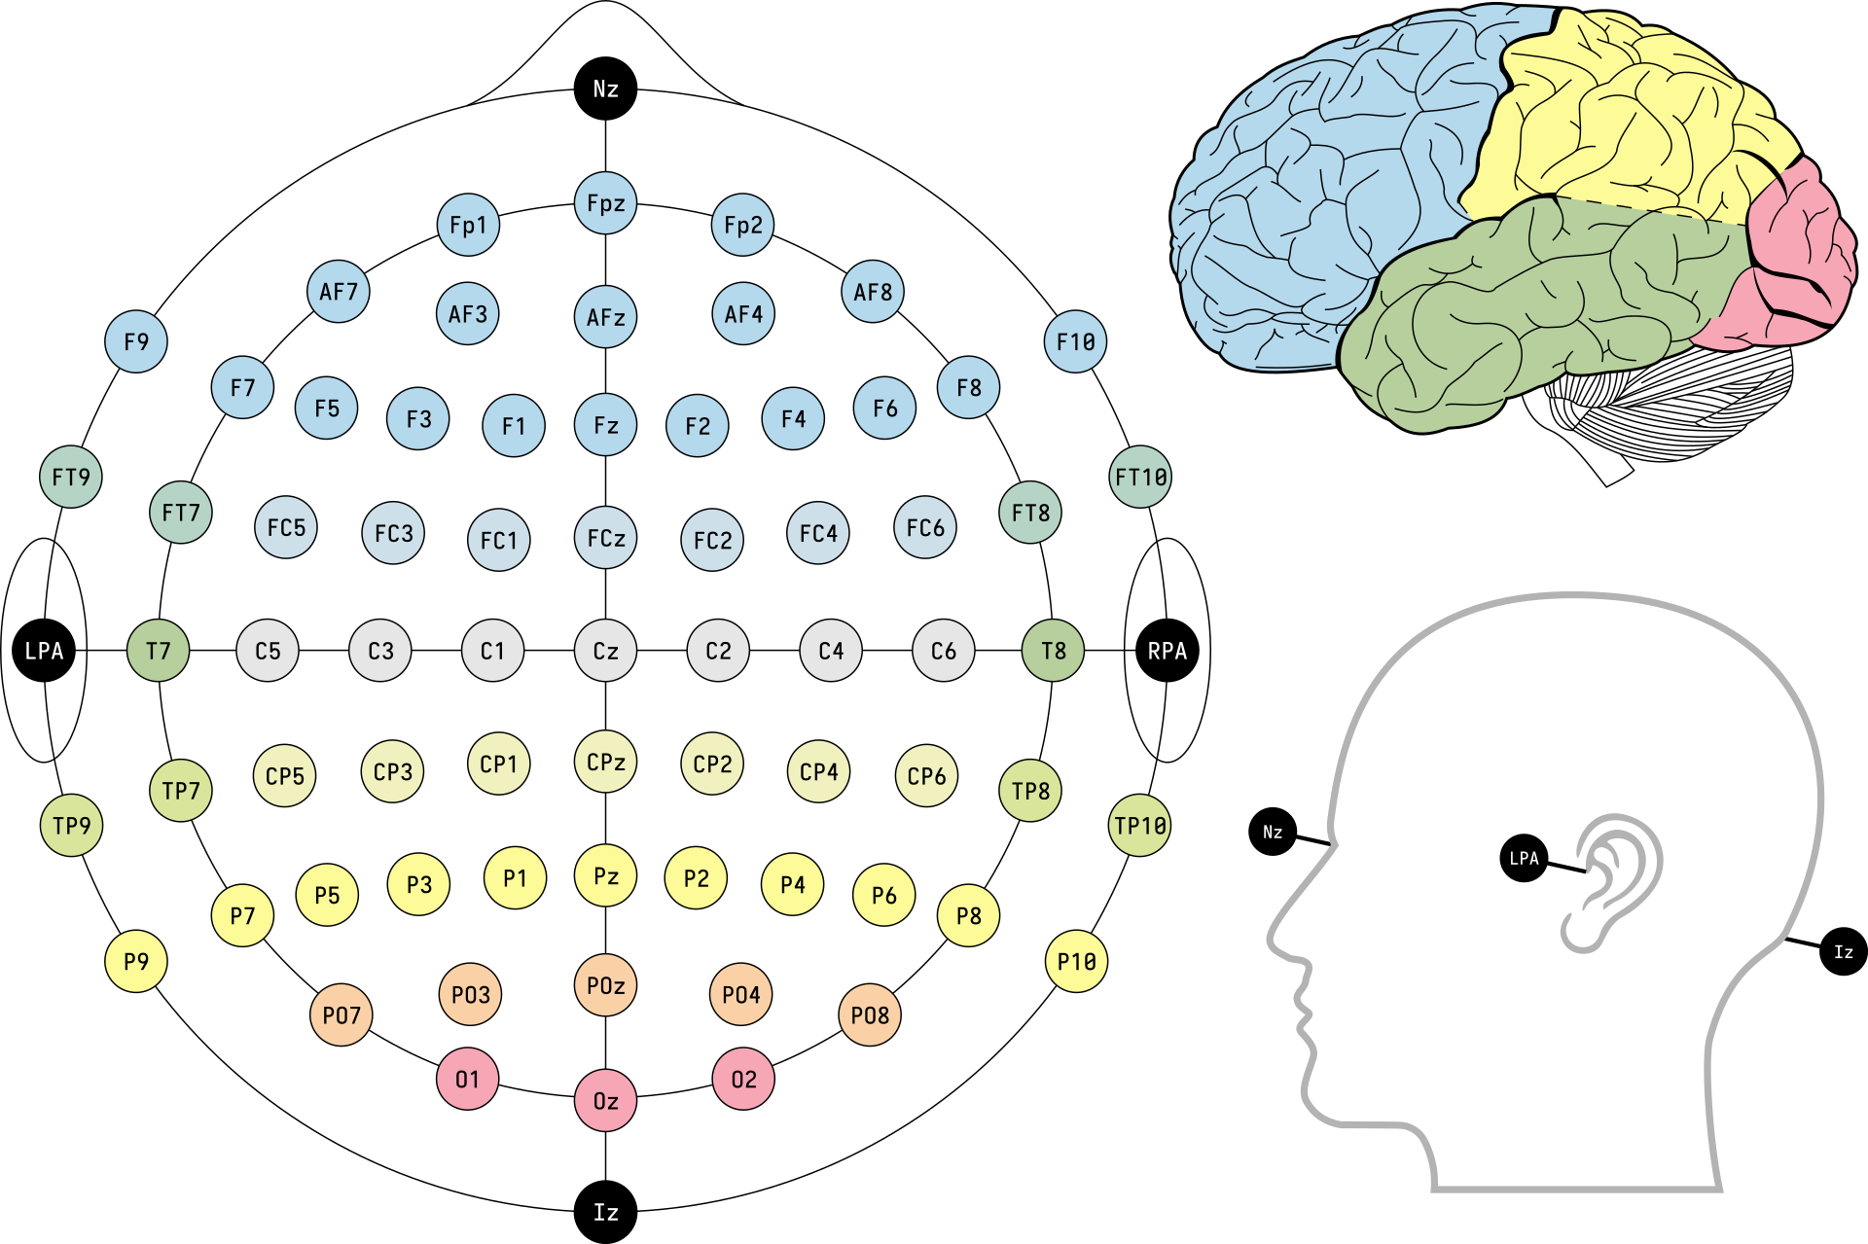
EMOTIV EPOC X
14 channel EEG for whole brain sensing
Saline Based Electrodes
Easy to hydrate
Bluetooth Wireless
9-axis motion sensor
Detect head movements
Notes:
The EEG device named EPOC X from EMOTIV
Has 14 channel EEG sensors for whole brain sensing
It use Saline Based Electrodes that is easy to hydrate
also this device connected with Bluetooth wireless system
And has 9-axis motion sensor so it can detect head movements

Slide 23
Youtube Video : experimented with using EMOTIV’s EPOC X
Controlling Electronics with my Mind! | EEG Brain Computer Interface
Notes:
Here is simple Youtube video that a YouTuber experimented with using EMOTIV's EPOC X.
어떤 유투버가 EMOTIV사의 EPOC X 를 활용하여 실험한 유투브 영상이다.

Slide 24
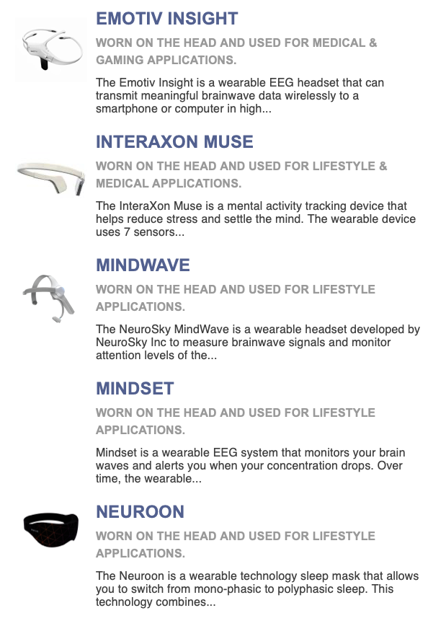
Various wearable EEG devices
There are more various wearable EEG devices like image
Each of them has there own characteristics like for gaming, medical, fitness, .etc

Slide 25
EEG & sleep
Notes:
이 섹션에서는 수면 상태에 따른 뇌전도의 특징과 수면을 돕는 장치에 대해 얘기한다.
In this section, I talk about the characteristics of EEG according to the state of sleep and the devices that help you sleep.

Slide 26
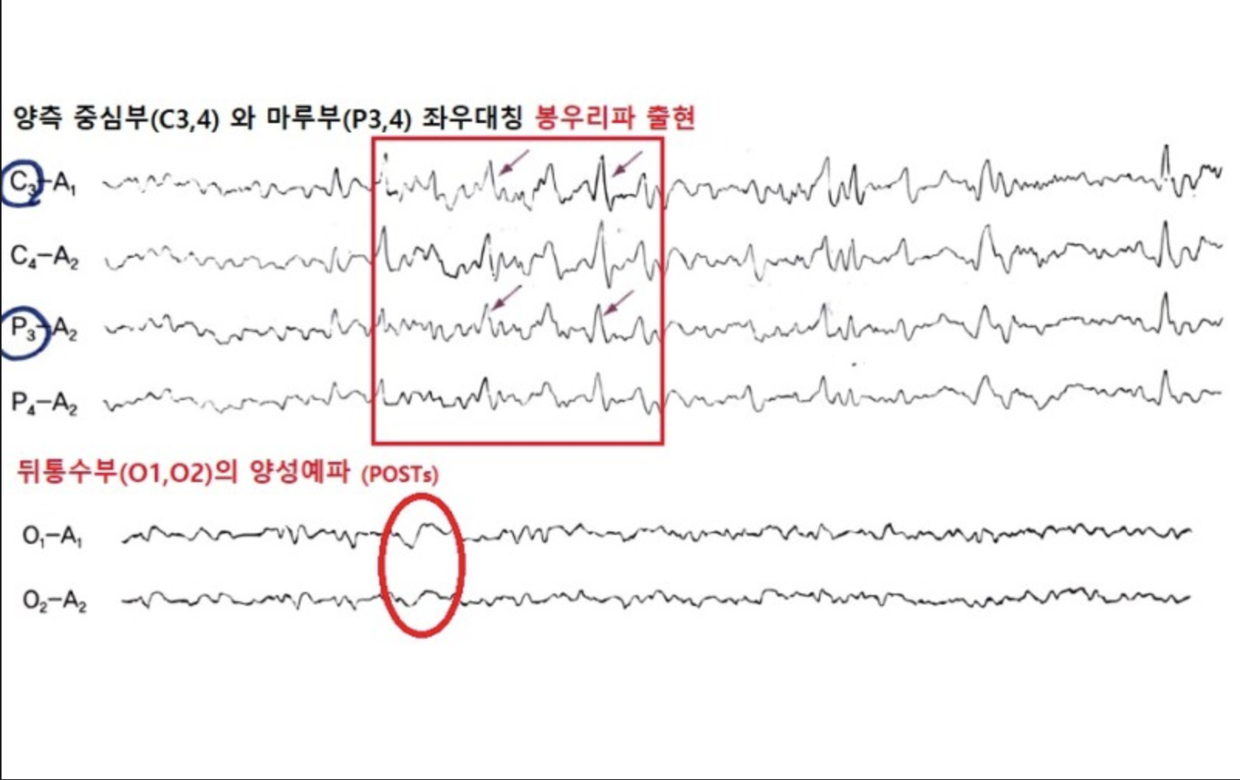
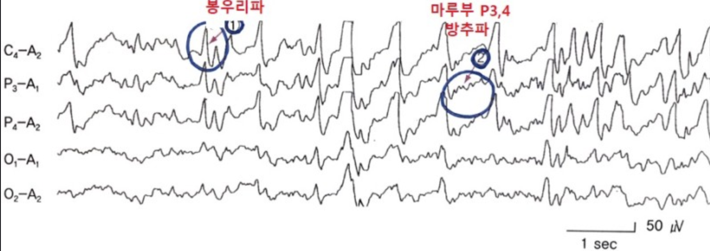
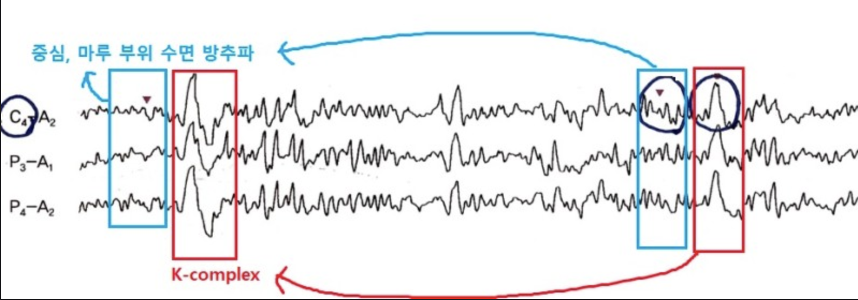
EEG & sleep
Drowsiness and Stage 1 - Non-REM
Shallow Sleep phase (Stage 2) - Non-REM
Peak wave
P3, P4
Symmetrical peak waves in both central parts(C3,4) and floor parts (P3,4)
Sleep spindle
Positive sharp wave (POSTs) at the back of the head (O1, O2)
C4, P3, P4 -> sleep spindle
K- complex
Sleep spindle : 12~14Hz
K-complex : High amplitude slow wave
Notes:
In the drowsy phase, the alpha waves in the back of the head decrease in continuity and amplitude. In addition, theta waves, which are slow waves of low amplitude, are the main ones, and symmetrical peak waves can be found in the both sides, C3,4, and P3,4. You can check the positive sharp wave in the back of the head. O1, O2
In the shallow sleep phase, the stage 2.
12~14Hz spindle wave and peak wave can be seen, most of which predominate near F3,4/F7,8 and C3,4. You can also check the K-complex signal in the stage 2. 졸음 단계에서는 뒤통수의 알파파가 연속성과 진폭이 감소합니다.
또한 저진폭의 느린파인 세타파가 주를 이루며, 좌우 대칭 피크파인 C3, 4, P3, 4를 확인할 수 있습니다.
당신은 뒤통수에 있는 양의 날카로운 파도를 확인할 수 있습니다. O1, O2
얕은 수면 단계에서는 12~14Hz 표면 스핀들파와 피크파를 볼 수 있으며, 대부분 F3,4/F7,8 및 C3,4 근처에서 우세합니다.
당신은 K-complex를 확인할 수 있습니다.

Slide 27
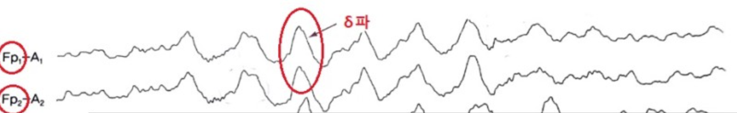
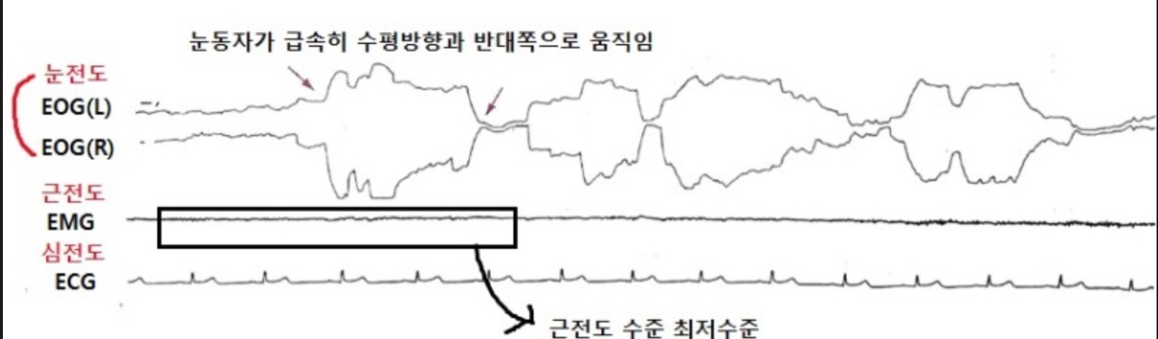
EEG & sleep
Stage4 - REM
𝞭 wave
Delta waves mainly appear at the forehead and are seen at the electrodes of the forehead, Fp1, 2.
REM
Eye movement rapidly opposite to horizontal direction
Lowest electromyogram level
Notes:
In Stage 4, a deep sleep phase, delta waves, which are slow waves with high amplitude, account for more than 50%, spindle wave does not appear. Delta waves mainly appear on the forehead side, and the electrodes on the forehead side are Fp1 and Fp2.
REM sleep occurs about 90 minutes after falling asleep, and every 90 minutes. At this time, the eyes move rapidly in the opposite direction from the horizontal direction, changes in the autonomic nervous system occur, brain metabolic activity increases, and muscle tone decreases. 깊은 수면기인 Stage4 에서는 높은 진폭의 느린파인 델타파가 50% 이상을 차지하고,
방추파가 출현하지 않는다.
델타파는 주로 이마쪽에서 나타나고, 이마쪽의 전극은 Fp1, 2 이다.
렘 수면기는 잠든 후 90분 정도 지나고, 90분마다 나타난다.
이때 눈동자가 급속히 수평방향과 반대쪽으로 움직이며, 자율신경의 변화가 생기고, 뇌 대사활동이 증가하며, 근긴장 저하 등의 특징이 있다.

Slide 28
EEG & sleep summary
stage | Stage explanation | Frequency Features | Other features
Awakening Awakening period | Awakening Awakening period | Alpha wave (8~13Hz) | Noise caused by movement and heartbeat
Stage 1 | Early light sleep phase | Mixed wave (2~7Hz) dominance, alpha wave 50% or less | No K-complex and sleep spindle
Stage 2 | Shallow sleep phase | Slow wave (0~2Hz) is less than 20% | K-complex and sleep spindle wave measured
Stage 3 | Severe sleep phase | Slow wave measured at 20% to 50%
Stage 4 | Deep sleep phase | Slow wave measured greater than 50%
REM | REM Sleeper | Mixed wave dominance | Noise caused by eye movement
Notes:
Here is the summary for every sleep stage and it’s features.
stage
Stage explanation
주파수 특징
기타 특징
각성
각성기
알파파(8~13Hz)
움직임과 심박으로 인한 노이즈 발생
Stage 1
얕은수면 초기
혼합파(2~7Hz) 우세, 알파파 50% 이하
K-복합체와 수면방추파 없음
Stage 2
얕은 수면기
느린파(0~2Hz)가 20% 이하
K-복합체와 수면방추파 측정됨
Stage 3
중증도수면기
느린파가 20%에서 50% 측정됨
Stage 4
깊은 수면기
느린파가 50% 이상 측정됨
REM
REM 수면기
혼합파 우세
안구 움직임으로 인한 노이즈 발생

Slide 29
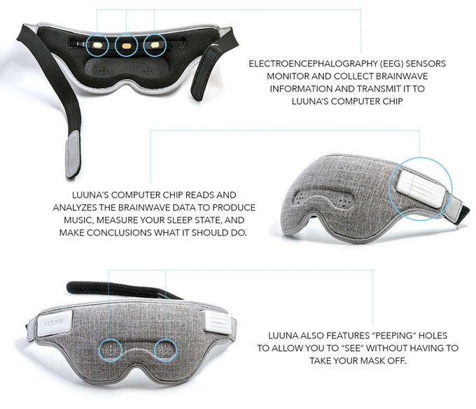
LUUNA : sleep assistant
Eeg sensors to monitor & collect brainwave information
Basically, luuna analyze brain waves for a good night's sleep
It naturally induces sleep with quiet music
If you set a time, when it's appropriate, luuna wake you up with an alarm
It also stabilizes brain waves by playing sounds suitable for brain wave stabilization
Notes:
LUUNA is the sleep assistant device.
it has Eeg sensors to monitor & collect brainwave information
Basically, luuna analyze brain waves for deep sleep
It naturally induces sleep with quiet music
If you set a time, when it's appropriate, luuna wake you up with an alarm
It also stabilizes brain waves by playing sounds suitable for brain wave stabilization

Slide 30
EEG & Dementia
Notes:
In this section I will talk about EEG and dementia

Slide 31
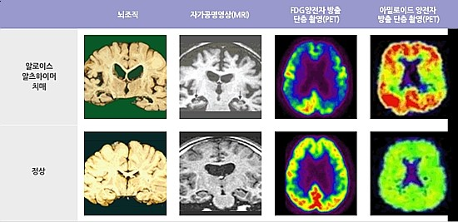
Diagnosis of dementia through biological signals (brain waves) 1
Brain tissue
MRI
Fluorodeoxyglucose
Positron Emission Tomography
Amyloid
Positron Emission Tomography
dementia
normal
Recently, a technology that can identify dementia early through EEG measurement and analysis technology is being developed
Originally, when dementia occurred, for example, MRI or amyloid PET tests had to be performed to determine whether it was Alzheimer's dementia, which took about two hours as of 2019, and the diagnosis cost was also high.
Notes:
최근 뇌파 측정과 분석기술을 통해 치매를 조기 판별할 수 있는 기술이 개발되고 있음
원래는 치매가 발생했을 때 예를 들어 그것이 알츠하이머 치매인지 아닌지를 확인하기 위해서는 MRI나 아밀로이드 PET 검사 등을 해야 했음 이는 2019년 기준 약 2시간정도 시간이 소요되었으며, 진단 비용 또한, 많이 들었음.

Slide 32
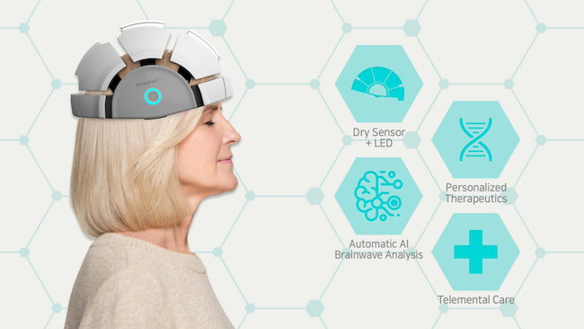
Diagnosis of dementia through biological signals (brain waves) 2
However, now, a new method is being developed to check dementia by looking at brain waves without high-cost tests such as amyloid PET tests
Testing using brain waves has the advantage of being able to find high-risk groups non-invasive and at low cost
Notes:
그런데 이제는 아밀로이드 PET 검사와 같은 고비용 검사 없이도 뇌파형을 보고 치매를 확인할 수 있는 방법이 새롭게 개발되고 있음
뇌파를 이용한 검사는 비침습적으로 그리고 저렴한 비용으로 고위험군을 찾아낼 수 있다는 장점이 있음

Slide 33
Uncertainty of diagnosis through brain waves 1
However, it is not yet clear whether it is dementia or not through EEG analysis
A domestic company called Megnosis showed 95% accuracy as a result of clinical trials at Seoul National University Hospital
In general, brain waves appear slowly and gently in tired or sleeping situations, and fast and dense brain waves appear in anxious or excessive tension
When the brain undergoes degenerative changes or trauma damage, such as Alzheimer's, Parkinson's, or stroke, brain cells are crushed and synapses that act as networking between brain cells are destroyed
And when the synapses break like this, a locally gentle, wide waveform appears
Notes:
그러나 아직까지는 뇌파 분석을 통해 치매인지 아닌지를 확실하게 알 수는 없음
메그노시스 라는 국내 기업 에서 서울대병원 임상실험 결과 95% 정확도를 보임
일반적으로, 뇌파는 피로하거나 수면을 취하고 있는 상황에서는 느리고 완만하게, 불안하거나 과도한 긴장 상태에서는 빠르고 촘촘한 뇌파가 나타나게 됨
알츠하이머나 파킨슨, 뇌졸중과 같이 뇌가 퇴행성 변화를 거치거나 외상으로 인한 손상이 발생하면 뇌세포들이 파쇄되고 뇌세포간 네트워킹 역할을 하는 시냅스가 망가지게 됨
그리고 이렇게 시냅스가 망가지면 국소적으로 완만하고 넓은 파형이 나타남

Slide 34
Uncertainty of diagnosis through brain waves 2
As previously mentioned, it is too early to diagnose 100% dementia only by looking at a certain pattern of brain waves because brain waves may appear slowly depending on various physical situations
More data will need to be accumulated, analyzed, and learned with artificial intelligence in the future to ensure accurate diagnosis
Notes:
앞과 같이, 여러 신체적인 상황에 따라 뇌파가 느리게 나타날수도 있기 때문에 뇌파의 일정 패턴만 보고 100% 치매라고 진단하기는 시기상조임
앞으로 더 많은 데이터가 축적되고 분석되고 이를 인공지능으로 학습시켜야 진단이 정확해질 것임

Slide 35
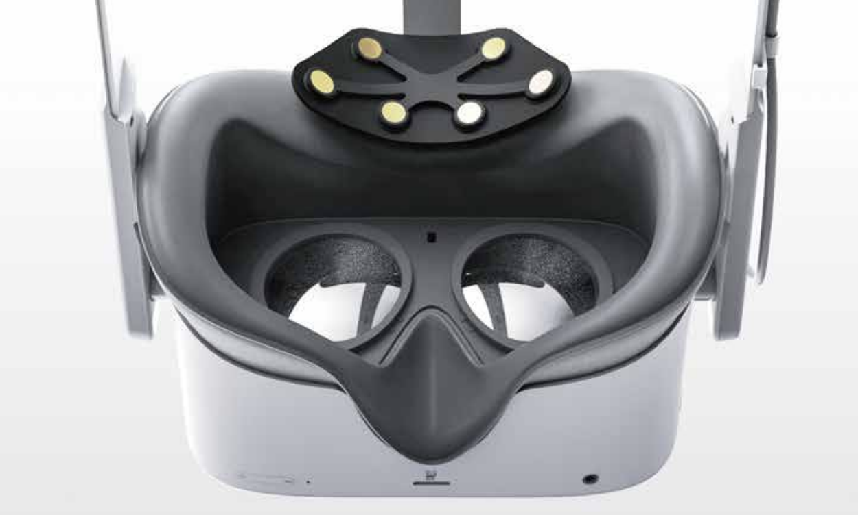
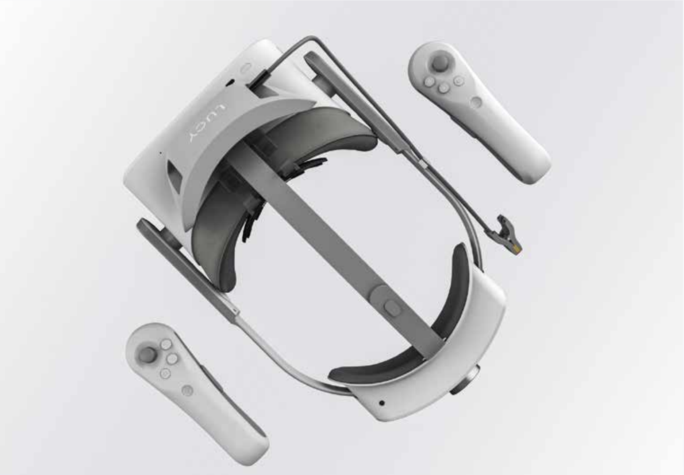
EEG and home dementia diagnostic devices
EEG + VR : LUCY
As mentioned earlier, the best way to respond to dementia is to diagnose it early and slow down the progression.
It is important to check and train cognitive function status periodically in everyday life
Looxidlabs - LUCY collects information on the response speed, brain waves, eye movements, etc. of users playing VR games -> Classify dementia by analyzing them using 6channel EEG measurement
61% accuracy
Notes:
It is a EEG wearable device for home dementia diagnose. Called LUCY.
This device combines EEG sensors and VR devices.
EEG + VR : LUCY
As mentioned earlier, the best way to respond to dementia is to diagnose it early and slow down the progression.
It is important to check and train cognitive function status periodically in everyday life
LUCY collects information on the response speed, brain waves, eye movements, etc. of users playing VR games -> Classify dementia by analyzing them using Eeg 6channel measurement
It reaches 61% accuracy on dementia diagnosis.
뇌파 + VR : LUCY 앞서 언급했듯이 치매에 대응하는 가장 좋은 방법은 조기에 진단하고 진행을 늦추는 것입니다. 일상생활에서 주기적으로 인지기능 상태를 확인하고 훈련하는 것이 중요합니다 Looxidlabs - LUCY는 응답 속도, 뇌파, 안구 운동 등에 대한 정보를 수집합니다. VR 게임을 하는 사용자의 비율 -> 치매를 분석하여 분류 Eeg 6채널 측정 61% 정확도

Slide 36
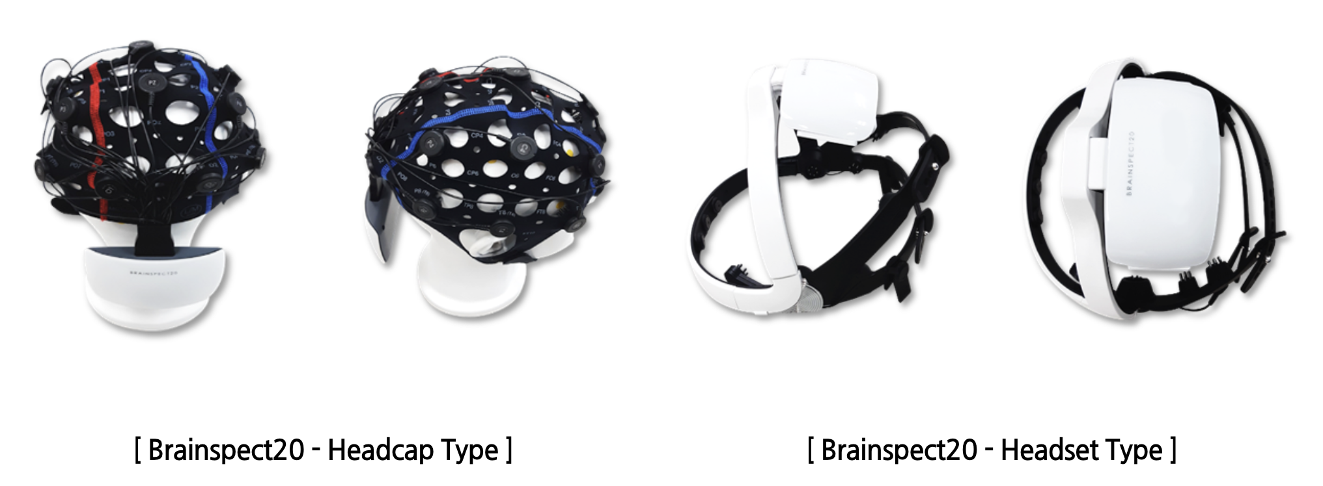
EEG and home dementia diagnostic devices
Interview video
Megnosis – KIMES 2023 – Bluetooth Wireless EEG Measurement Device – 10 min of rest -> Mild Cognitive Disorder Identification
95% accuracy using 20 channel EEG measurement
Notes:
This video is megnosis interview on KIMES 2023
The man from the Megnosis said, that they achieved 95% of accuracy for diagnose Mild Cognitive Disorder Identification.
And, he said it is the world best record.
This device uses 20 channel EEG measurement.
메그노시스 – KIMES 2023 – 블루투스 무선 뇌파 측정 장치 – 휴식 10분 -> 경도인지 장애 식별 20채널 EEG 측정을 사용한 95% 정확도

